Slide 1
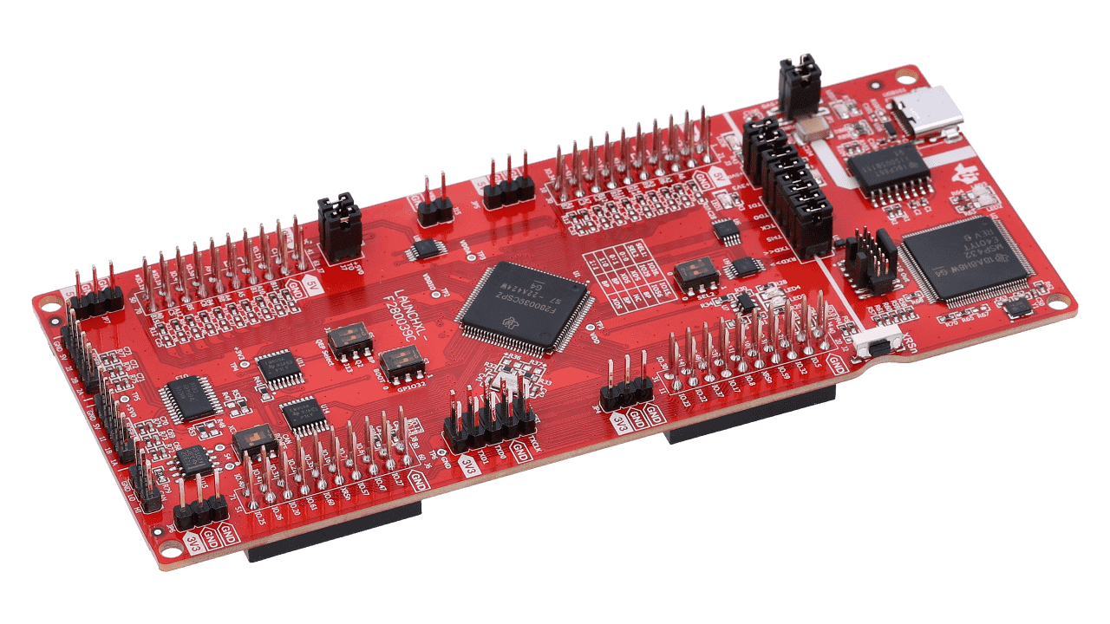

Team 1: ADC Resolution vs. Sensorless Motor Control Performance
Bi-Weekly Update 2 Cristian Ornelas, Tyler Hawkins, Tamara Basfar, John King Sponsor: Kevin Allen (Texas Instruments) TA: Fahrettin Ay
Notes:
Intro should take 30 seconds

Slide 2
Project Summary
Problem: How do different configurations of sensorless motor control affect performance?
Solution: Port the universal motor control software to one of TI’s newest c2000 devices. Develop updated configurations of the universal solution, and test the effects on sensorless control performance.
Notes:
Kyle

Slide 3
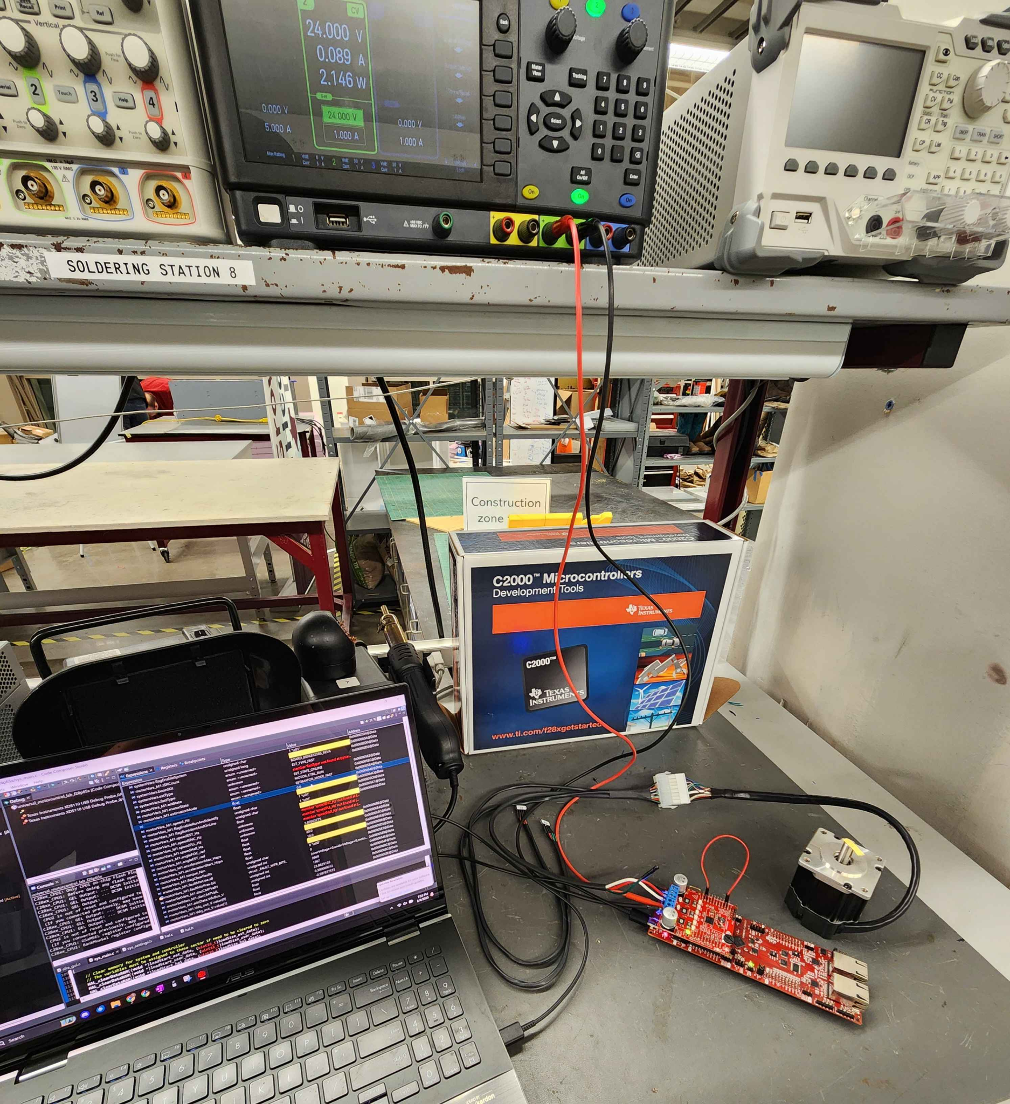
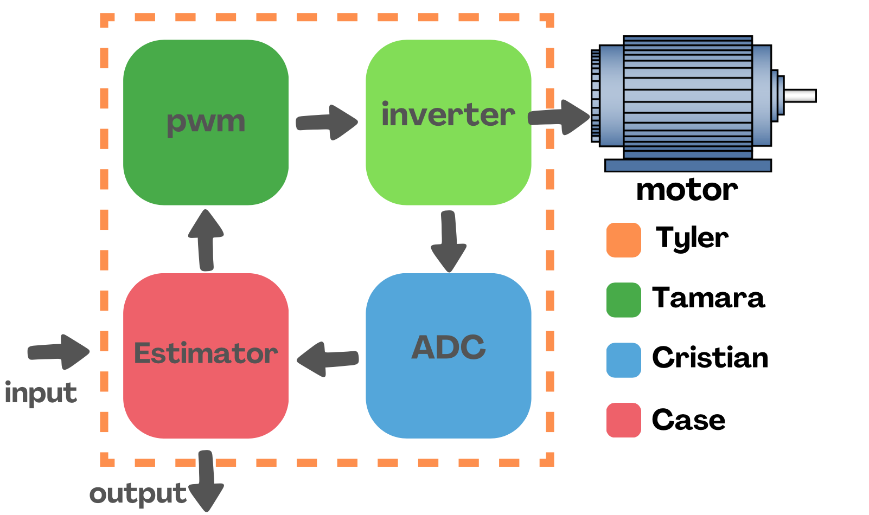
Project/Subsystem Overview
Notes:
Eric

Slide 4
Project Timeline
Port motor control solution to F28P65x Board (completed 1/30) | Modify software to enable data capture (to complete by 2/20) | Modify software for ADC resolution (12/16) bit (to complete by 3/6) | Modify software to run using 32/64 bit floating point (to complete by 3/6) | Modify software to enable oversampling (to complete by 3/6) | Test full software compatibility (to complete by 3/24) | Full system Validation/ testing (to complete by 3/27) | Demo and Report (to complete by 4/21)
Notes:
-- Save discussion for subsystem update
-- Save detail for execution plan & validation plan status

Slide 5
Floating Point Values
Case King
Accomplishments since last update 11 hrs of effort | Ongoing progress/problems and plans until the next presentation
Validated the Estimator Code from the ported solution. The Code has been mapped out and all areas that will require updating have been marked. | I plan on creating a new copy that will allow the code to run in float 64 parameters.

Slide 6
12/16 Bit ADC Resolution
Cristian Ornelas
Accomplishments since last update 12 hrs of effort | Ongoing progress/problems and plans until the next presentation
Validated the ADC code of the ported solution and successfully ported the sensorless motor control to the new c2000 board as a team. Mapped out the spots in each file where the 12-bit needs to be interchangeable with 16-bit adc resolution. | I plan on continue updating the code so that 16-bit adc resolution can be implemented along with 12-bit adc resolution.

Slide 7
Oversampling
Tamara Basfar
Accomplishments since last update 12 hrs of effort | Ongoing progress/problems and plans until the next presentation
Validated the PWM code of the ported solution and successfully ported the sensorless motor control to the new c2000 board as a team. identified sections where oversampling should be enabled | Have a working version of the sensorless solution with oversampling enabled comparing performance

Slide 8
Test Data Acquisition
Tyler Hawkins
Accomplishments since last update 10 hrs of effort | Ongoing progress/problems and plans until the next presentation
-Solution successfully ported to F28P65X C2000 device. -Identified necessary control parameters to identify performance changes within the code. | Develop a system to capture motor control data for testing and comparison. By next update graphs should be able to be created using gather data from motor control.

Slide 9
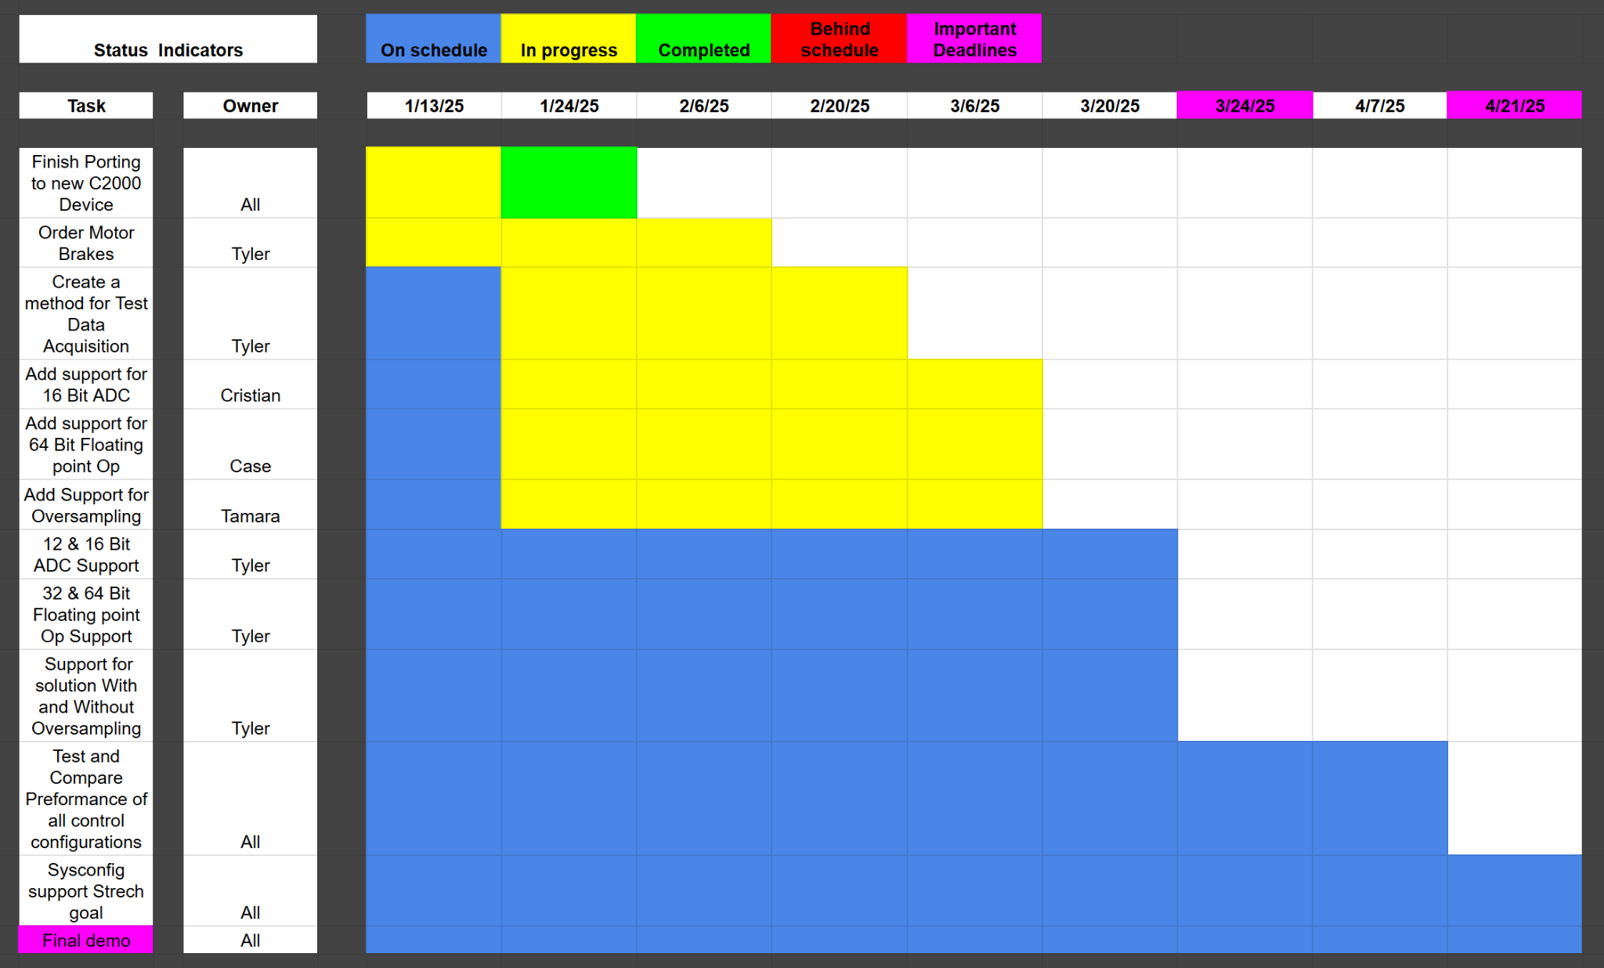
Execution Plan
Notes:
Michelle

Slide 10
Validation Plan
Task | Specification | Result | Owner
Porting Solution onto F28p65x board | Ported motor control software onto f28p65x board successfully according to the Universal Motor control guide | PASSED | All
16 Bit ADC resolution | The system correctly operates using 16-bit ADC resolution according to The Universal Motor control guide | UNTESTED | Cristian
64-bit Floating point operation | The system Correctly Operates using 64-bit Floating Point according to The Universal Motor control guide | UNTESTED | Case
Enable oversampling | The system Correctly Operates while oversampling is enabled according to The Universal Motor control guide | UNTESTED | Tamara
12 Bit & 16 Bit ADC resolution Support | The system correctly operates using either 12-bit or 16-bit ADC resolutions according to The Universal Motor control guide | UNTESTED | Cristian

Slide 11
Validation Plan
Task | Specification | Result | Owner
32-bit & 64-bit Floating point operation | The system Correctly Operates using either 32-bit or 64-bit Floating Point according to The Universal Motor control guide | UNTESTED | Tyler
Test data acquisition | The system Correctly gathers test data for the following parameters: speed ripple, speed step, and load step. Able to be graphed and differences should be able to be seen. | UNTESTED | Tyler
Test 12 vs 16 Bit performance | Test the performance of 12-bit and 16-bit ADC resolutions: speed ripple, speed step, load step. | UNTESTED | Cristian
Test 32-bit & 64-bit Floating-point performance | Test the performance of 32-bit and 64-bit ADC Floating point operations: speed ripple, speed step, load step. | UNTESTED | Case
Test the performance of oversampling | Test the effectiveness of oversampling: speed ripple, speed step, load step. | UNTESTED | Tamara

Slide 12
Thanks & Gig’em
Team 1: ADC Resolution vs. Sensorless Motor Control Performance

